Slide 1
HNDIT1104: Data Representation and Organization
Number systems & Conversion
Part 3
Lesson 4

Slide 2
Learning Objectives
At the end of the lesson students should be able to
Convert Binary number to Decimal
Convert Binary fraction to Decimal
Convert Octal number to Decimal
Convert Octal fraction to Decimal

Slide 3
Binary to Decimal
Decimal
Octal
Binary
Hexadecimal

Slide 4
Converting a Binary Number into Decimal
Technique
- Multiply each bit in the binary number with the weight (or position)
- Add up all the results of the multiplication performed
- The desired decimal number is the total of the multiplication results performed

Slide 5
Example
a)111001₂
=(1x2⁵)+ (1x2⁴) + (1x2³) + (0x2²) +(0x2¹) + (1x2⁰)
= 32 + 16 + 8 + 0 + 0 + 1
= 57₁₀
b)00011010₂
= 2⁴ + 2³ +2¹
= 16 + 8 + 2
= 26₁₀
Start at the right most bit

Slide 6
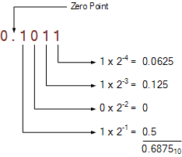
Converting a Binary Fraction into Decimal

Slide 7
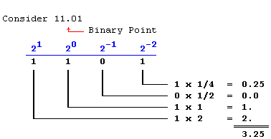
Example:

Slide 8
Octal to Decimal
Decimal
Octal
Binary
Hexadecimal

Slide 9
Converting Octal to Decimal
What is the decimal equivalent of the octal number 642?
= (6 x 8²) + (4 x 8¹) + (2 x 8º) = 6 x 64 + 4 x 8 + 2 x 1
= 384+ 32 + 2
= 418
11

Slide 10
Conversion of Fractional Octal to Decimals
Pair Work: Group, workout and Present
Convert Following Octal to Decimals
Ex1: 0.15
Ex2: 0.24
Ex3: 0.46

